Slide 1


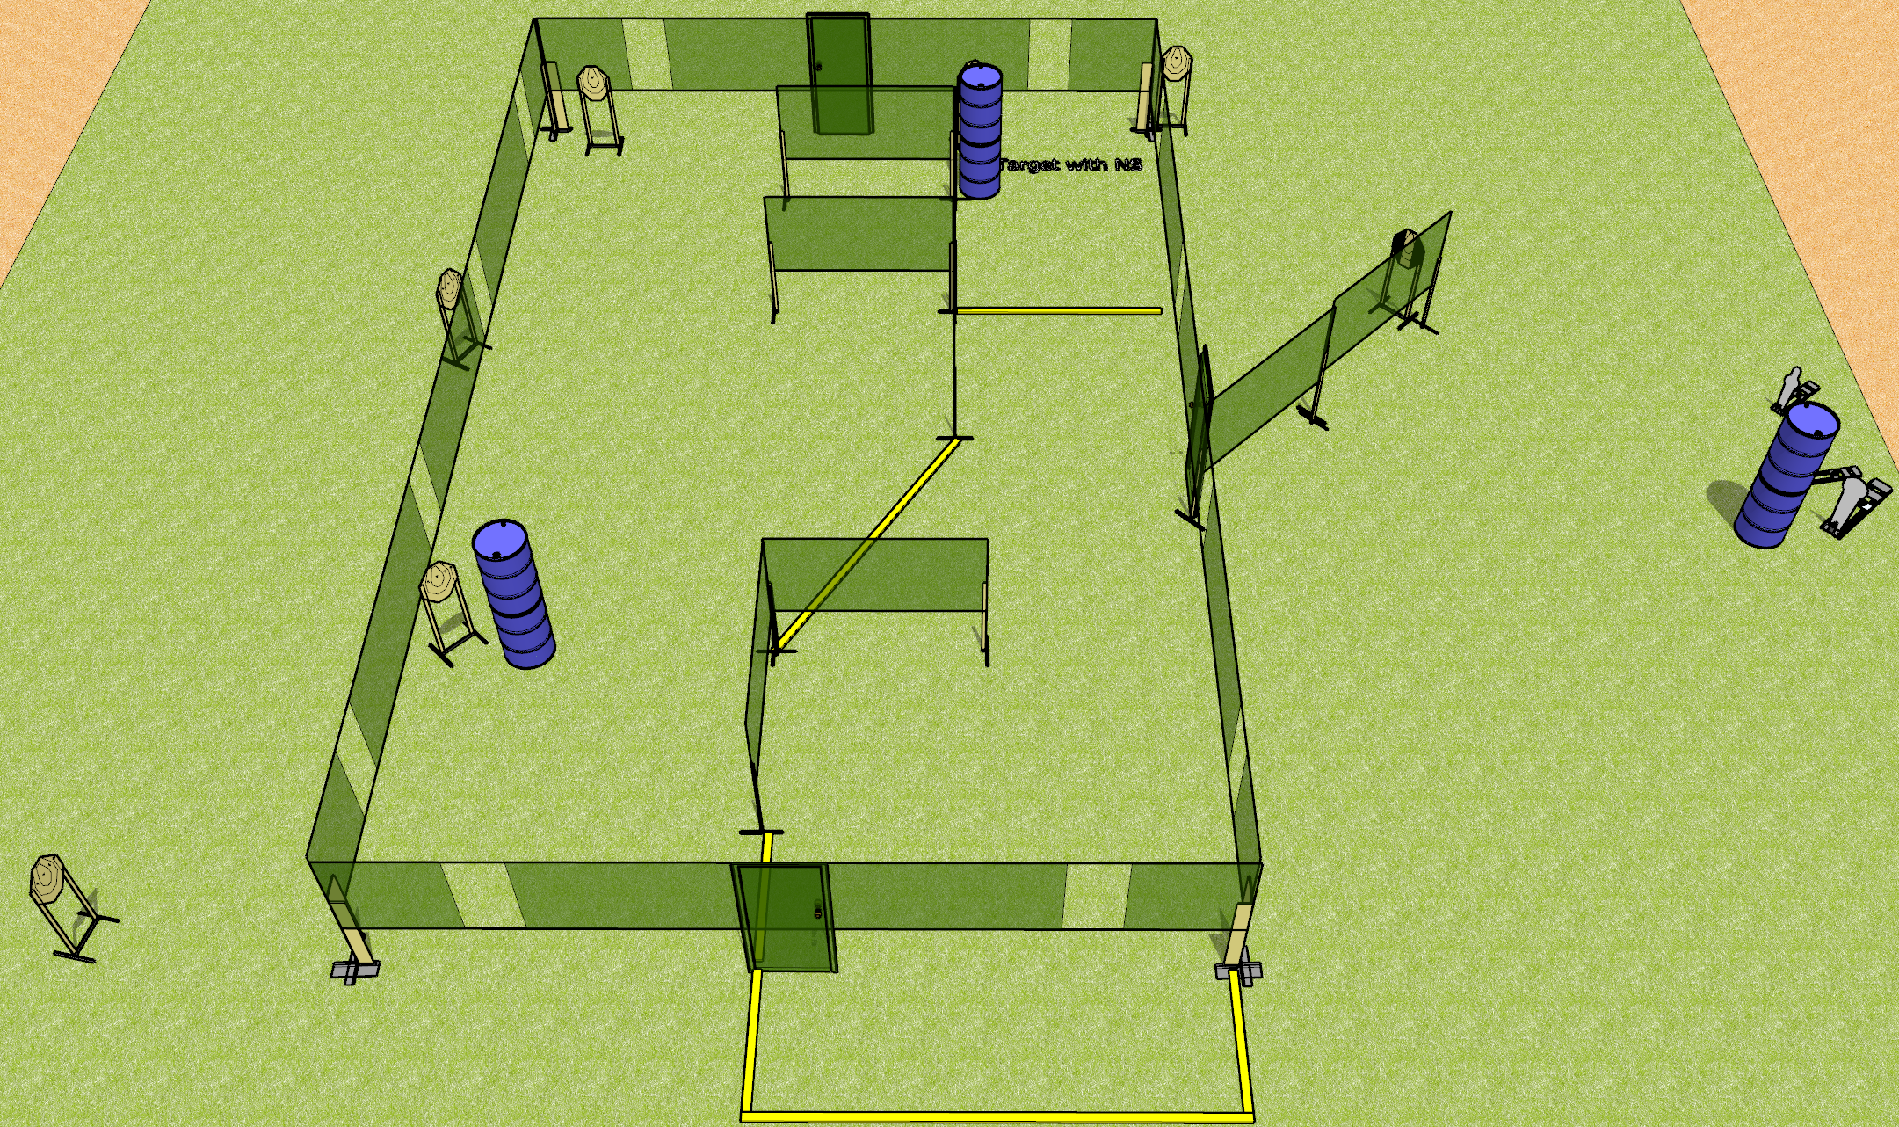
 | Dothan Gun Club – USPSA Match Unexpected Detour Course Designer : Drew Coleman
Round Count 24 rounds 7 IPSC 1 colt popper, 2 mini poppers
Equipment List 3 medium fault lines 3 wall feet 1 tuxedo

Slide 2
Unexpected Detour
Written Stage Briefing
Unexpected Detour is a 24 round, 120 point, Comstock course of fire. There are 7 IPSC targets, 1 colt popper, and 2 mini poppers. The best 3 hits on paper will score, and steel must fall to score. The start signal is audible.
Handgun start position is completely outside the shooting area, wrists below belt. Handgun is loaded and holstered.
PCC start position is completely outside the shooting area, stock on belt. Loaded carbine is held with both hands, safety on.
On start signal, engage target as they become available from within the shooting area.

